Slide 1

4.4
Mean Median Average
© 2010 Pearson Education, Inc.
All rights reserved.

Slide 2
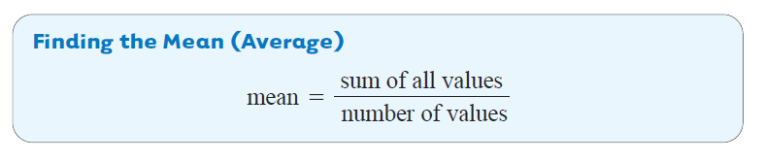
When analyzing data, one of the first things to look for is a measure of central tendency – a single number that we can use to represent the entire list of numbers.
One such measure is the average or mean.
Copyright © 2010 Pearson Education, Inc. All rights reserved.

Slide 3
Parallel
Example 1
Finding the Mean
Kaylee has test scores of 91, 88, 82, 95, 80, and 98. Find the mean (average) of her scores.
Use the formula for finding the mean.
Kaylee has a mean score of 89.
Copyright © 2010 Pearson Education, Inc. All rights reserved.

Slide 4
Parallel
Example 2
Applying the Average or Mean
The sales at a local farmer’s market each day last week were
$104, $81, $92, $112, $75, $138, $155
Find the mean daily sales to the nearest cent.
The mean daily sales at the market was $108.14.
Copyright © 2010 Pearson Education, Inc. All rights reserved.
Slide 4-4- 4

Slide 5
Parallel
Example 3
Understanding the Weighted Mean
A garbage man tracks the number of garbage bags collected per house for the first neighborhood of his route. Find the weighted mean.
# of bags | Frequency
1 | 2
2 | 5
3 | 4
4 | 8
5 | 7
6 | 5
Copyright © 2010 Pearson Education, Inc. All rights reserved.
Slide 4-4- 5

Slide 6
Parallel
Example 3
continued
Understanding the Weighted Mean
To find the mean, multiply the number of bags by its frequency. Then add the products. Next, add the number in the frequency column to find the total number of bags.
# of bags | Frequency | Product
1 | 2
2 | 5
3 | 4
4 | 8
5 | 7
6 | 5
Totals | 31
(1 ∙ 2) = 2
(2 ∙ 5) = 10
(3 ∙ 4) = 12
(4 ∙ 8) = 32
(5 ∙ 7) = 35
(6 ∙ 5) = 30
121
Copyright © 2010 Pearson Education, Inc. All rights reserved.
Slide 4-4- 6

Slide 7
Parallel
Example 3
Understanding the Weighted Mean
Finally divide the totals. Round to the nearest hundredth.
The mean garbage bags per house was 3.90 bags.
Copyright © 2010 Pearson Education, Inc. All rights reserved.
Slide 4-4- 7

Slide 8
Parallel
Example 4
Applying the Weighted Mean
Find the grade point average for a student earning the following grades. Assume A = 4, B = 3, C = 2, D = 1 and F = 0.
Course | Credits | Grade | Credits ∙ Grades
Mathematics | 4 | A (= 4)
English Lit. | 3 | A (= 4)
Latin | 3 | C (= 2)
Chemistry | 4 | B (= 3)
Government | 2 | C (= 2)
Totals
4 ∙ 4 = 16
3 ∙ 4 = 12
3 ∙ 2 = 6
4 ∙ 3 = 12
2 ∙ 2 = 4
16
50
Copyright © 2010 Pearson Education, Inc. All rights reserved.
Slide 4-4- 8

Slide 9
Parallel
Example 4
continued
Applying the Weighted Mean
It is common to round grade point average to the nearest hundredth. So the grade point average for the student is rounded to 3.13.
Copyright © 2010 Pearson Education, Inc. All rights reserved.
Slide 4-4- 9

Slide 10
Parallel
Example 5
Finding the Median for an Odd Number of Items
Find the median for the following list of prices for men’s ties.
$22, $15, $36, $18, $30
First arrange the numbers in numerical order from smallest to largest.
$15, $18, $22, $30, $36
Next, find the middle number in the list.
$15, $18, $22, $30, $36
Two below
Middle number
Two above
The median price is $22.
Copyright © 2010 Pearson Education, Inc. All rights reserved.
Slide 4-4- 10

Slide 11
Parallel
Example 5
Finding the Median for an Even Number of Items
Find the median for the following list of ages.
49, 11, 62, 37, 29, 56
First arrange the numbers in numerical order from smallest to largest. Then find the middle.
11, 29, 37, 49, 56, 62
Middle two numbers
The median age is the mean of the two middle numbers.
Copyright © 2010 Pearson Education, Inc. All rights reserved.
Slide 4-4- 11

Slide 12
Parallel
Example 6
Finding the Mode
Find the mode for each list of numbers.
a. 12, 41, 16, 73, 16, 24
The number 16 occurs most often and is therefore the mode.
b. 926, 924, 921, 928, 921, 926, 923, 927
Both 921 and 926 occur twice, so each is a mode.
c. $14,715, $10,917, $18,726, $11,946, $17,391
No number occurs more than once. The list has no mode.
Copyright © 2010 Pearson Education, Inc. All rights reserved.
Slide 4-4- 12

Slide 13
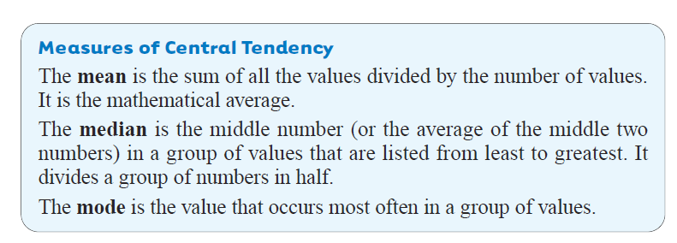
Copyright © 2010 Pearson Education, Inc. All rights reserved.
Slide 4-4- 13

